Slide 1




Tools for HTML, CSS and JavaScript
HTML Basics
Telerik Software Academy
http://academy.telerik.com

Slide 2
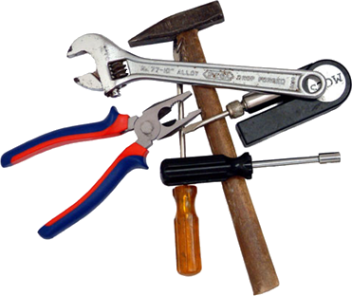

Table of Contents
Coding Tools (IDEs)
Sublime Text
Atom
WebStorm
Visual Studio
Browsers and Browser Tools
Drawing and Slicing Tools

Slide 3
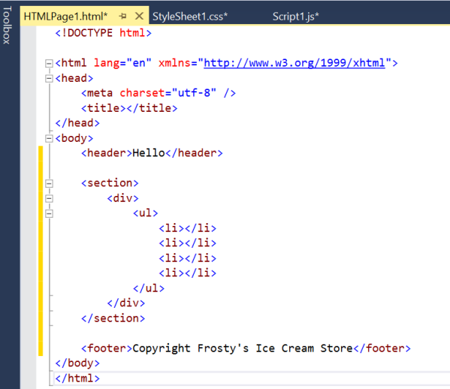
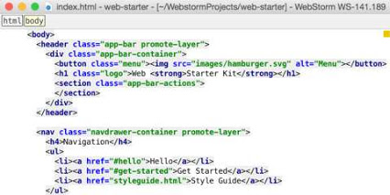
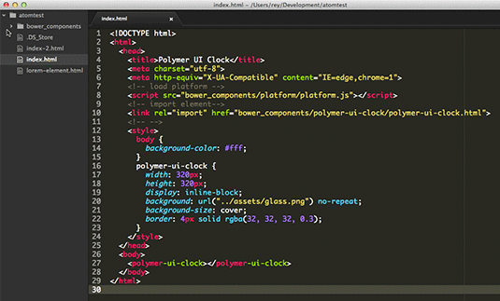
Coding Tools
Some of the many

Slide 4
Coding Tools
There are many, many coding tools for HTML, CSS and JavaScript
They are cross-platform
Some of the most used are:
Sublime Text 2/3
Atom.io
Jetbrains WebStorm
Microsoft Visual Studio
Eclipse, Aptana, Komodo IDE, Notepad++

Slide 5
Sublime Text
Sublime Text is a sophisticated text editor for code, markup and prose
Free to use with unlimited trial version
Has two versions, currently used
Sublime Text 2
Stable
Less updates
Sublime Text 3
Regular updates
Can crash right-out-of-nowhere
Yet, the better choice

Slide 6
Sublime Text (2)
Sublime Text is a text editor with a little ready-to-use functionality
Yet, it is easily customizable
A lot of free plugins (packages)
A package installer and a "store" with free packages at https://packagecontrol.io/
A ready-to-use portable version for HTML, CSS and JS development can be downloaded at
http://minkov.it/sublimetext-portable.zip

Slide 7
Sublime Text
Live Demo

Slide 8
Atom.io
Atom.io is "A hackable text editor for the 21st Century"
Built with HTML, CSS and JavaScript for development of HTML, CSS and JavaScript
Small and fast
Good set of plugins
Open-source
free to use and extend
From the creators of GitHub

Slide 9
Atom.io
Live Demo

Slide 10
Jetbrains WebStorm
Jetbrains WebStorm is a ready-to-use IDE for JavaScript development
Including web development with HTML and CSS
WebStorm has most of the necessary features for web development
Code highlighting
Code completion
Not that many plugins
WebStorm is a paid software
Yet, JetBrains offer a discount (100%) for students or start-ups

Slide 11
Jetbrains WebStorm
Live Demo

Slide 12
Microsoft Visual Studio
Microsoft Visual Studio is a ready-to-use IDE for web development
Built-in
Code highlighting
Code completion
And more
Visual Studio Ultimate is a not a free software
A free community (or express version) is available for download
Install Web Essentials extension

Slide 13
Microsoft Visual Studio
Live Demo

Slide 14
Browsers and Browser Tools
Browsers
Internet Explorer
Google Chrome
Mozilla Firefox
Apple Safari
Opera
Browser Tools
Firebug
WebInspector
WebDeveloper Toolbar
F12 (IE)
Inspect
Console
Bookmarklets

Slide 15
Browsers and Browser Tools
Live Demo

Slide 16



Drawing and Slicing Tools
Adobe Photoshop
Adobe Fireworks
Gimp
Paint.NET

Slide 17
Tools for HTML, CSS and JS
?
?
?
?
?
Questions?
?
?
?
?
?
http://academy.telerik.com

Slide 18




Free Trainings @ Telerik Academy
"Web Design with HTML5, CSS3 and JavaScript" course @ Telerik Academy
html5course.telerik.com
Telerik Software Academy
academy.telerik.com
Telerik Academy @ Facebook
facebook.com/TelerikAcademy
Telerik Software Academy Forums
forums.academy.telerik.com

